Slide 1
18.3 Decision Trees
Instructor: Qiang Yang
Hong Kong University of Science and Technology
Qyang@cs.ust.hk
Thanks: Eibe Frank and Jiawei Han
Notes:
Lecture 1

Slide 2
DECISION TREE [Quinlan93]
An internal node represents a test on an attribute.
A branch represents an outcome of the test, e.g., Color=red.
A leaf node represents a class label or class label distribution.
At each node, one attribute is chosen to split training examples into distinct classes as much as possible
A new case is classified by following a matching path to a leaf node.

Slide 3
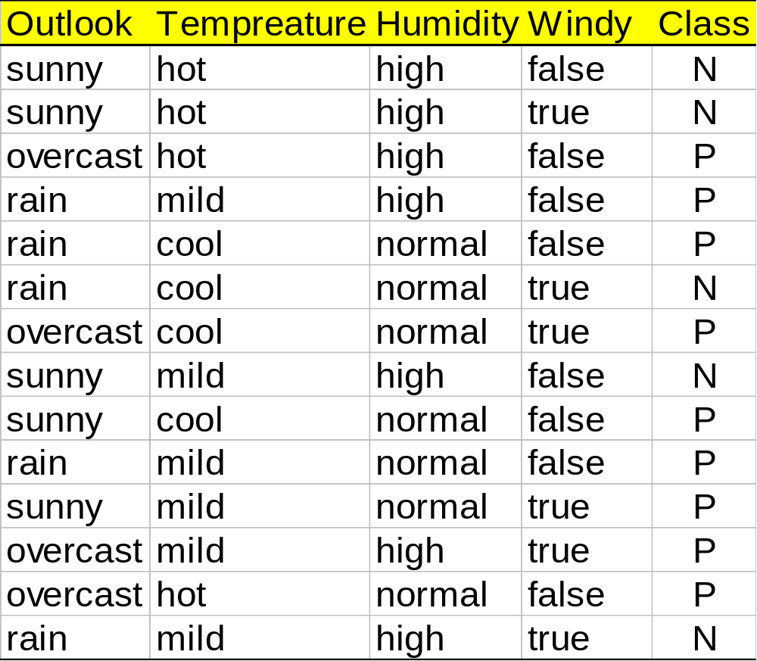
Training Set

Slide 4
Example
Outlook
sunny
overcast
rain
overcast
humidity
P
windy
high
normal
true
false
N
P
N
P

Slide 5
Building Decision Tree [Q93]
Top-down tree construction
  At start, all training examples are at the root.
  Partition the examples recursively by choosing one attribute each time.
Bottom-up tree pruning
  Remove subtrees or branches, in a bottom-up manner, to improve the estimated accuracy on new cases.

Slide 6
Choosing the Splitting Attribute
At each node, available attributes are evaluated on the basis of separating the classes of the training examples. A Goodness function is used for this purpose.
Typical goodness functions:
  information gain (ID3/C4.5)
  information gain ratio
  gini index

Slide 7
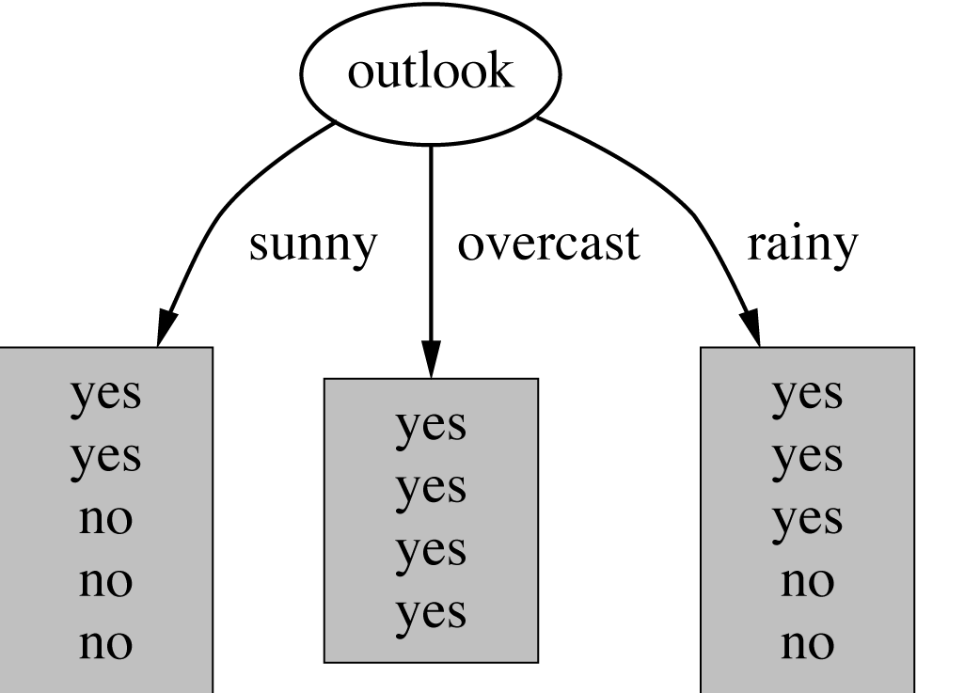
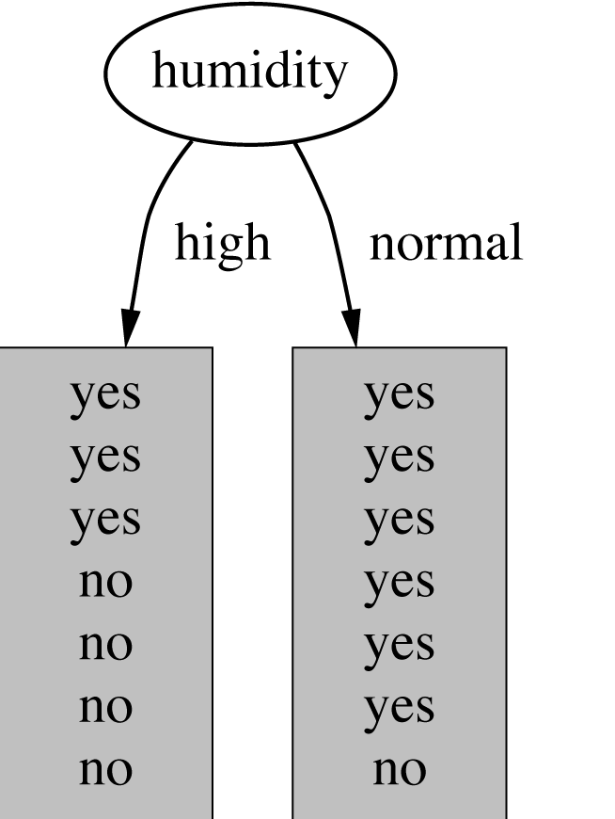
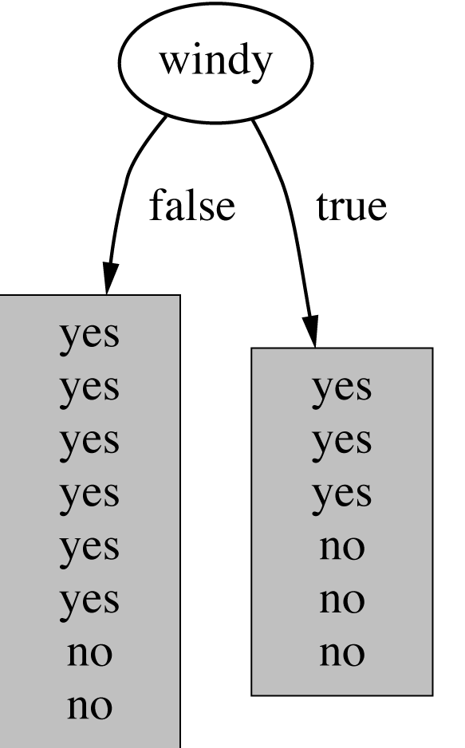
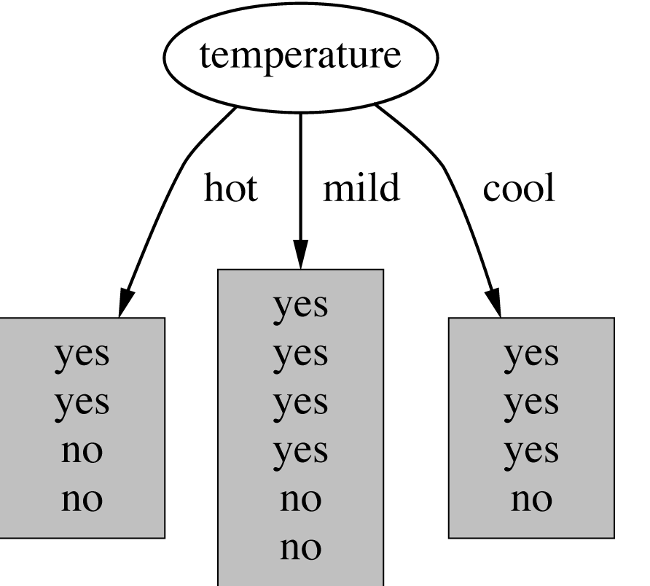
Which attribute to select?

Slide 8
A criterion for attribute selection
Which is the best attribute?
  The one which will result in the smallest tree
  Heuristic: choose the attribute that produces the “purest” nodes
Popular impurity criterion: information gain
  Information gain increases with the average purity of the subsets that an attribute produces
Strategy: choose attribute that results in greatest information gain

Slide 9
Computing information
Information is measured in bits
  Given a probability distribution, the info required to predict an event is the distribution’s entropy
  Entropy gives the information required in bits (this can involve fractions of bits!)
Formula for computing the entropy:

Slide 10

Example: attribute “Outlook”
“Outlook” = “Sunny”:
“Outlook” = “Overcast”:
“Outlook” = “Rainy”:
Expected information for attribute:
Note: this is
normally not
defined.

Slide 11


Computing the information gain
Information gain: information before splitting – information after splitting
Information gain for attributes from weather data:

Slide 12
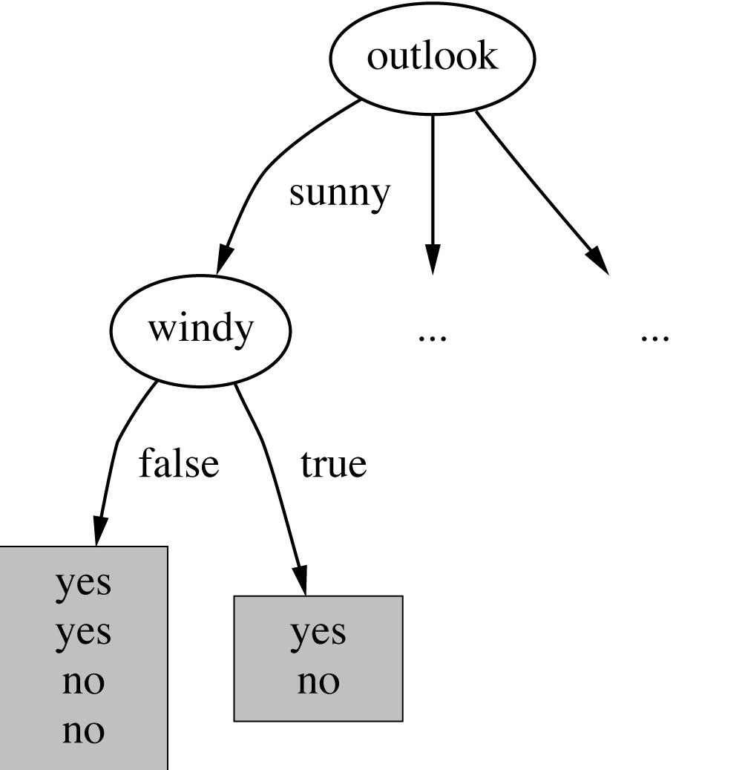
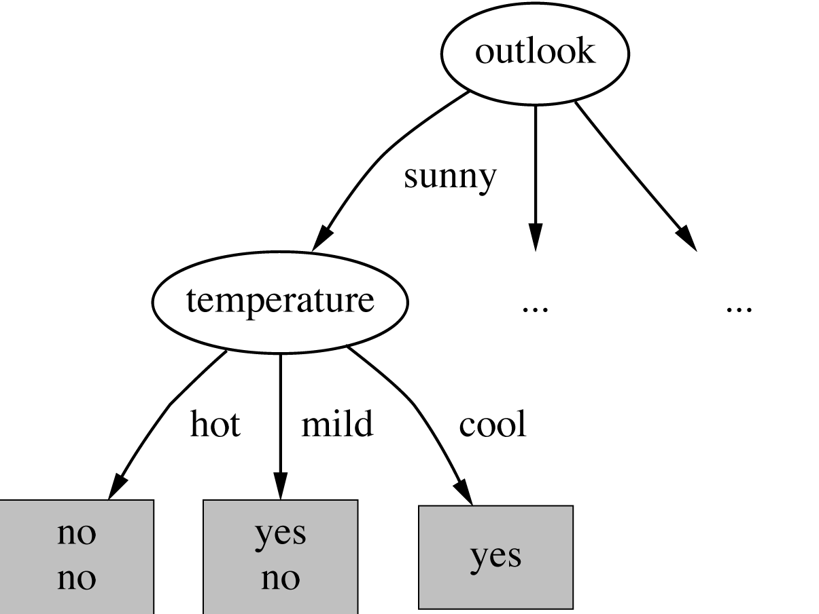
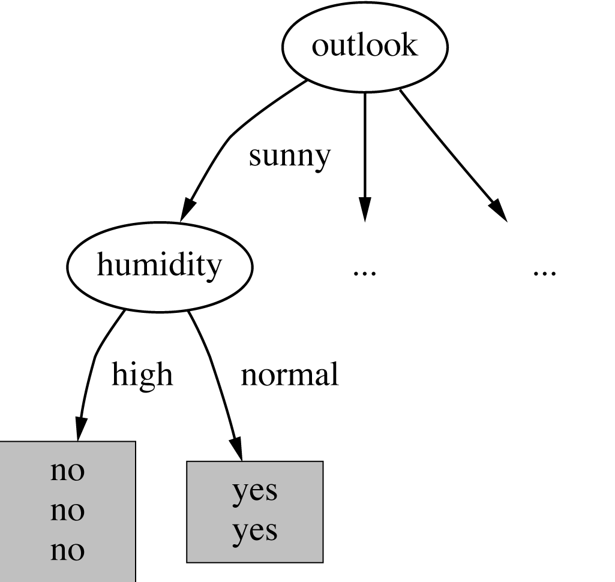

Continuing to split

Slide 13
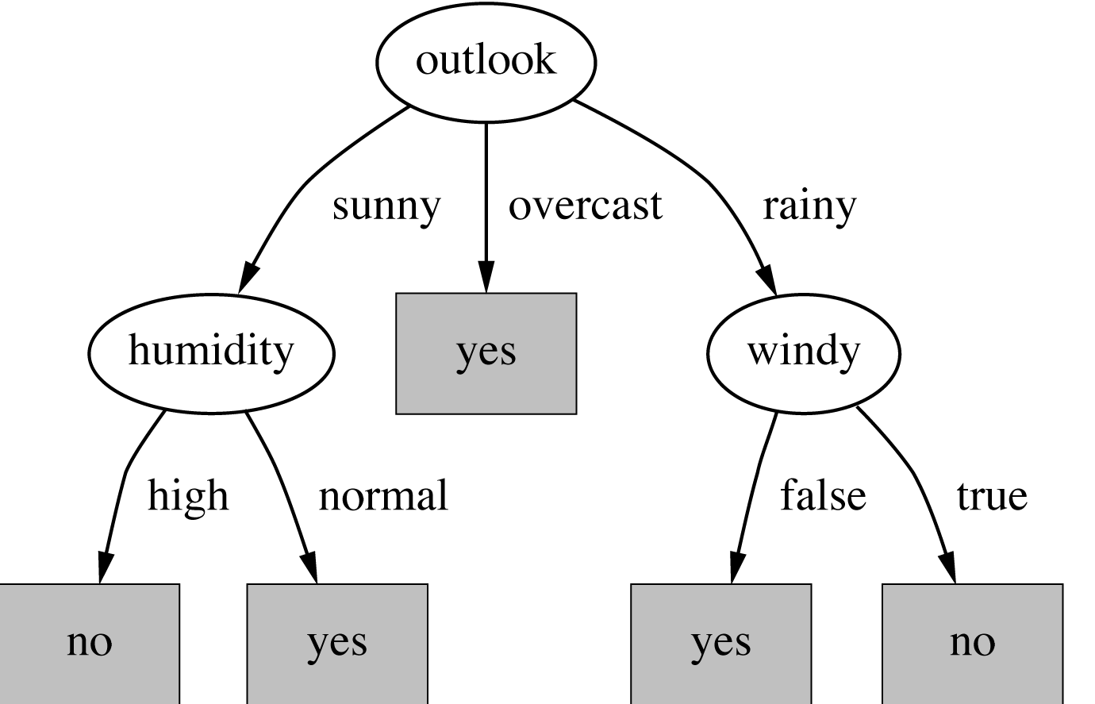
The final decision tree
Note: not all leaves need to be pure; sometimes identical instances have different classes
  ⇒ Splitting stops when data can’t be split any further

Slide 14
Highly-branching attributes
Problematic: attributes with a large number of values (extreme case: ID code)
Subsets are more likely to be pure if there is a large number of values
  Information gain is biased towards choosing attributes with a large number of values
  This may result in overfitting (selection of an attribute that is non-optimal for prediction)
Another problem: fragmentation

Slide 15
The gain ratio
Gain ratio: a modification of the information gain that reduces its bias on high-branch attributes
Gain ratio takes number and size of branches into account when choosing an attribute
  It corrects the information gain by taking the intrinsic information of a split into account
  Also called split ratio
Intrinsic information: entropy of distribution of instances into branches
  (i.e. how much info do we need to tell which branch an instance belongs to)

Slide 16
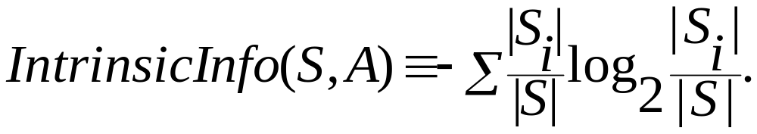
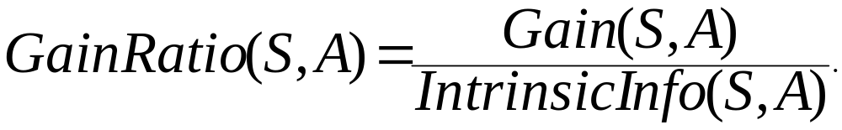
Gain Ratio
Gain ratio should be
  Large when data is evenly spread
  Small when all data belong to one branch
Gain ratio (Quinlan’86) normalizes info gain by this reduction:

Slide 17
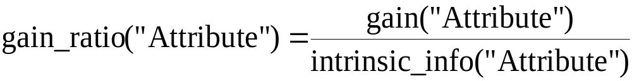
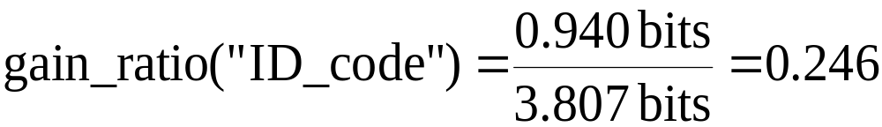
Computing the gain ratio
Example: intrinsic information for ID code
Importance of attribute decreases as intrinsic information gets larger
Example of gain ratio:
Example:

Slide 18
Gain ratios for weather data
Outlook |  | Temperature
Info: | 0.693 | Info: | 0.911
Gain: 0.940-0.693 | 0.247 | Gain: 0.940-0.911 | 0.029
Split info: info([5,4,5]) | 1.577 | Split info: info([4,6,4]) | 1.362
Gain ratio: 0.247/1.577 | 0.156 | Gain ratio: 0.029/1.362 | 0.021
Humidity |  | Windy
Info: | 0.788 | Info: | 0.892
Gain: 0.940-0.788 | 0.152 | Gain: 0.940-0.892 | 0.048
Split info: info([7,7]) | 1.000 | Split info: info([8,6]) | 0.985
Gain ratio: 0.152/1 | 0.152 | Gain ratio: 0.048/0.985 | 0.049

Slide 19
More on the gain ratio
“Outlook” still comes out top
However: “ID code” has greater gain ratio
  Standard fix: ad hoc test to prevent splitting on that type of attribute
Problem with gain ratio: it may overcompensate
  May choose an attribute just because its intrinsic information is very low
  Standard fix:
    First, only consider attributes with greater than average information gain
    Then, compare them on gain ratio

Slide 20
Discussion
Consider the following variations of decision trees

Slide 21
1. Apply KNN to each leaf node
Instead of choosing a class label as the majority class label, use KNN to choose a class label

Slide 22
2. Apply Naïve Bayesian at each leaf node
For each leave node, use all the available information we know about the test case to make decisions
Instead of using the majority rule, use probability/likelihood to make decisions

